Slide 1
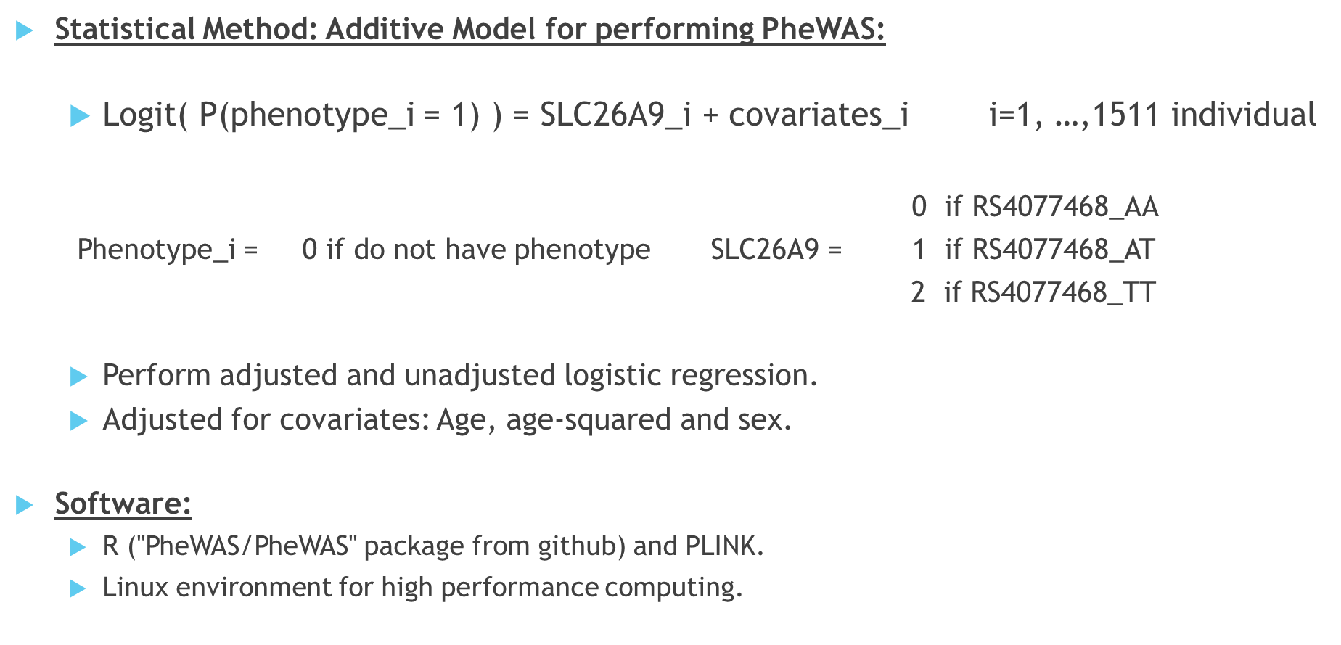
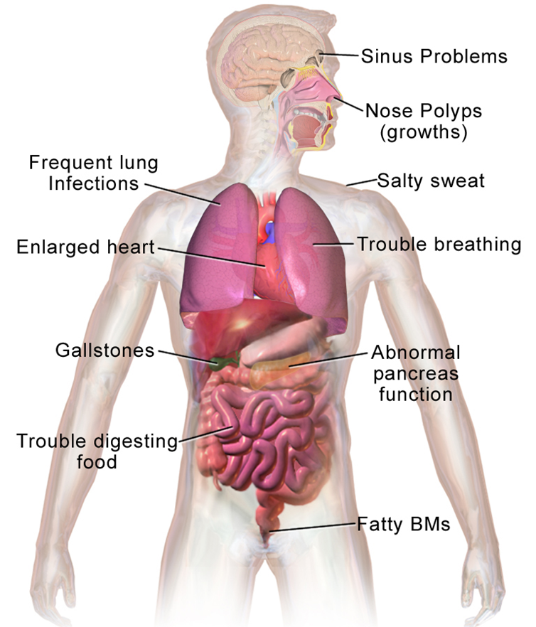
This Scientific Poster Template Is Provided By MakeSigns
Enter A Title And Add Logos To Your Poster
Add Author Names and Information
Include University or Department Names if Needed
ABSTRACT
2. METHODOLOGY
3. RESULTS
Add your information, graphs and images to this section.
Add your information, graphs and images to this section.
Add your information, graphs and images to this section.
Add your information, graphs and images to this section.
Phenotypic data
(ICD10 data)
N = 349,590
Genotypic data
N = 488,377
Unrelated Individuals
N = 452,197
Kinship analysis (removed people up to 2nd degree of relatedness)
Caucasians
N = 377,961
Ancestral PCA (removed non-Caucasian individuals)
Final data
N = 263,607
Merged phenotypic data from ICD10 codes with genotypic data
1. INTRODUCTION
1.1. CYSTIC FIBROSIS
Fig 1. Issues associated with CF
Add your information, graphs and images to this section.
Cystic fibrosis (CF) is the most common fatal genetic disease affecting Canadian children and young adults.
At present, there is no cure.
4. CONCLUSION
Results suggest that there maybe an association between gene SLC9A3 near SNP rs57221529, and having Esophagitis, GERD and related diseases.
Every additional C allele increases the odds by about 6.4% of having the related diseases in an individual.
Results generalizable to people with Caucasian ancestry.
With this PheWAS we may have found a phenotype associated with gene SCL9A3 in the non-CF population
However, further research work is required.
1.2. MODIFIER GENES
5. ACKNOWLEDGEMENTS
Add your information, graphs and images to this section.

